Slide 1

Chatting Application on Local Network
Python (Hybrid) Final Project
Komal Chandrakant Bhapkar

Slide 2
Want to Chat with your Friends ? Use my Chatting App ….

Slide 3
Tools & Concept
The project was created using Python along with the following libraries & Concepts:
Socket: For opening socket between users and transmitting the files
OS: For extracting basename and File Size
Hashlib: For calculating MD5 hash of message
Time: For inserting delay for synchronisation between users
File Handling : For reading and writing files
Exception Handling : To avoid runtime errors
OPPs : Hash Calculation is implemented using OPPs methods

Slide 4
I want to build a project which everyone can use in day to day life , my chatting app we can use easily across local network for easy & secure communication without internet. We can use it in classroom where mobile phones are not allowed.
My Chatting apps helps me to explore Socket concept..

Slide 5
Overview of Chatting App
There are two codes for two users Server and Client
Both users are having their Text files and their socket for file transmission
Server is opening the Socket & waiting for Client
Client is connecting to the Server via Socket
Client write message into its Text file & Calculate Hash of that message
Client send its Text file to Server, after that it also send Hash
Server receives the Text file from Client , write its content into its (Server's) Text file
Server calculate Hash from Received message
Server compares Calculated Hash with Received Hash , if it matches then it Read the Message, otherwise it prints 'Message is Tempered'
To send message to Client ,Server follows same process as the Client
Chatting get close if Server sends 'bye' message

Slide 6
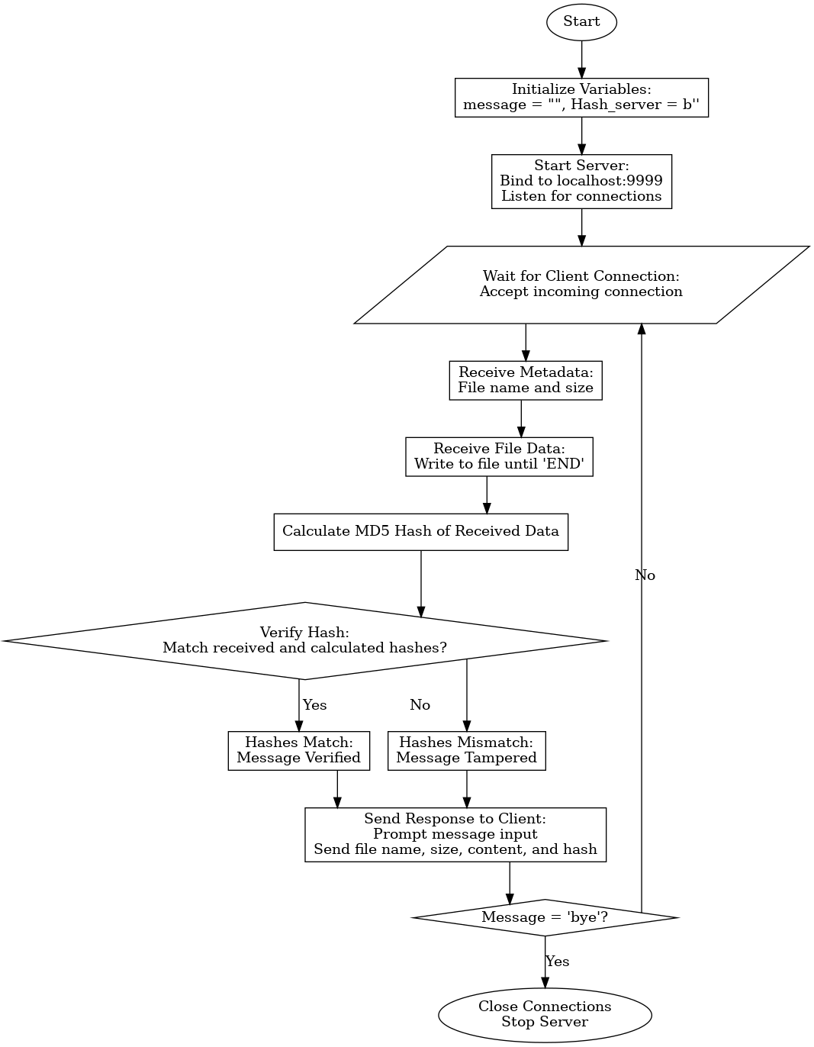
Flow Chart of
Server Code:

Slide 7
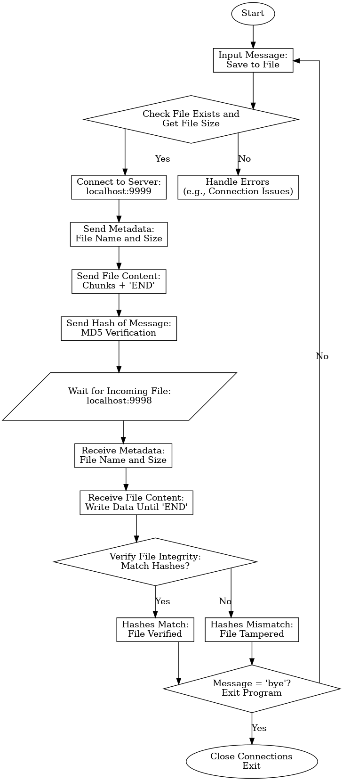
Flow Chart of Client Code:

Slide 8
Real World Implication
Chat App use for Seamless chatting in local area network
It provide secure communication, since messages are protected by MD5 Hash

Slide 9
Difficulties in building Chat App
Sometimes length of the message ,actual message and hash of the message are getting append
Synchronisation between users was a challenge socket connection was getting close before expectation
I resolved them by adding sleep function of time library
Socket closure was not handled by one user, so I implemented a patch of code which gives authority to Server python script to close the socket

Slide 10
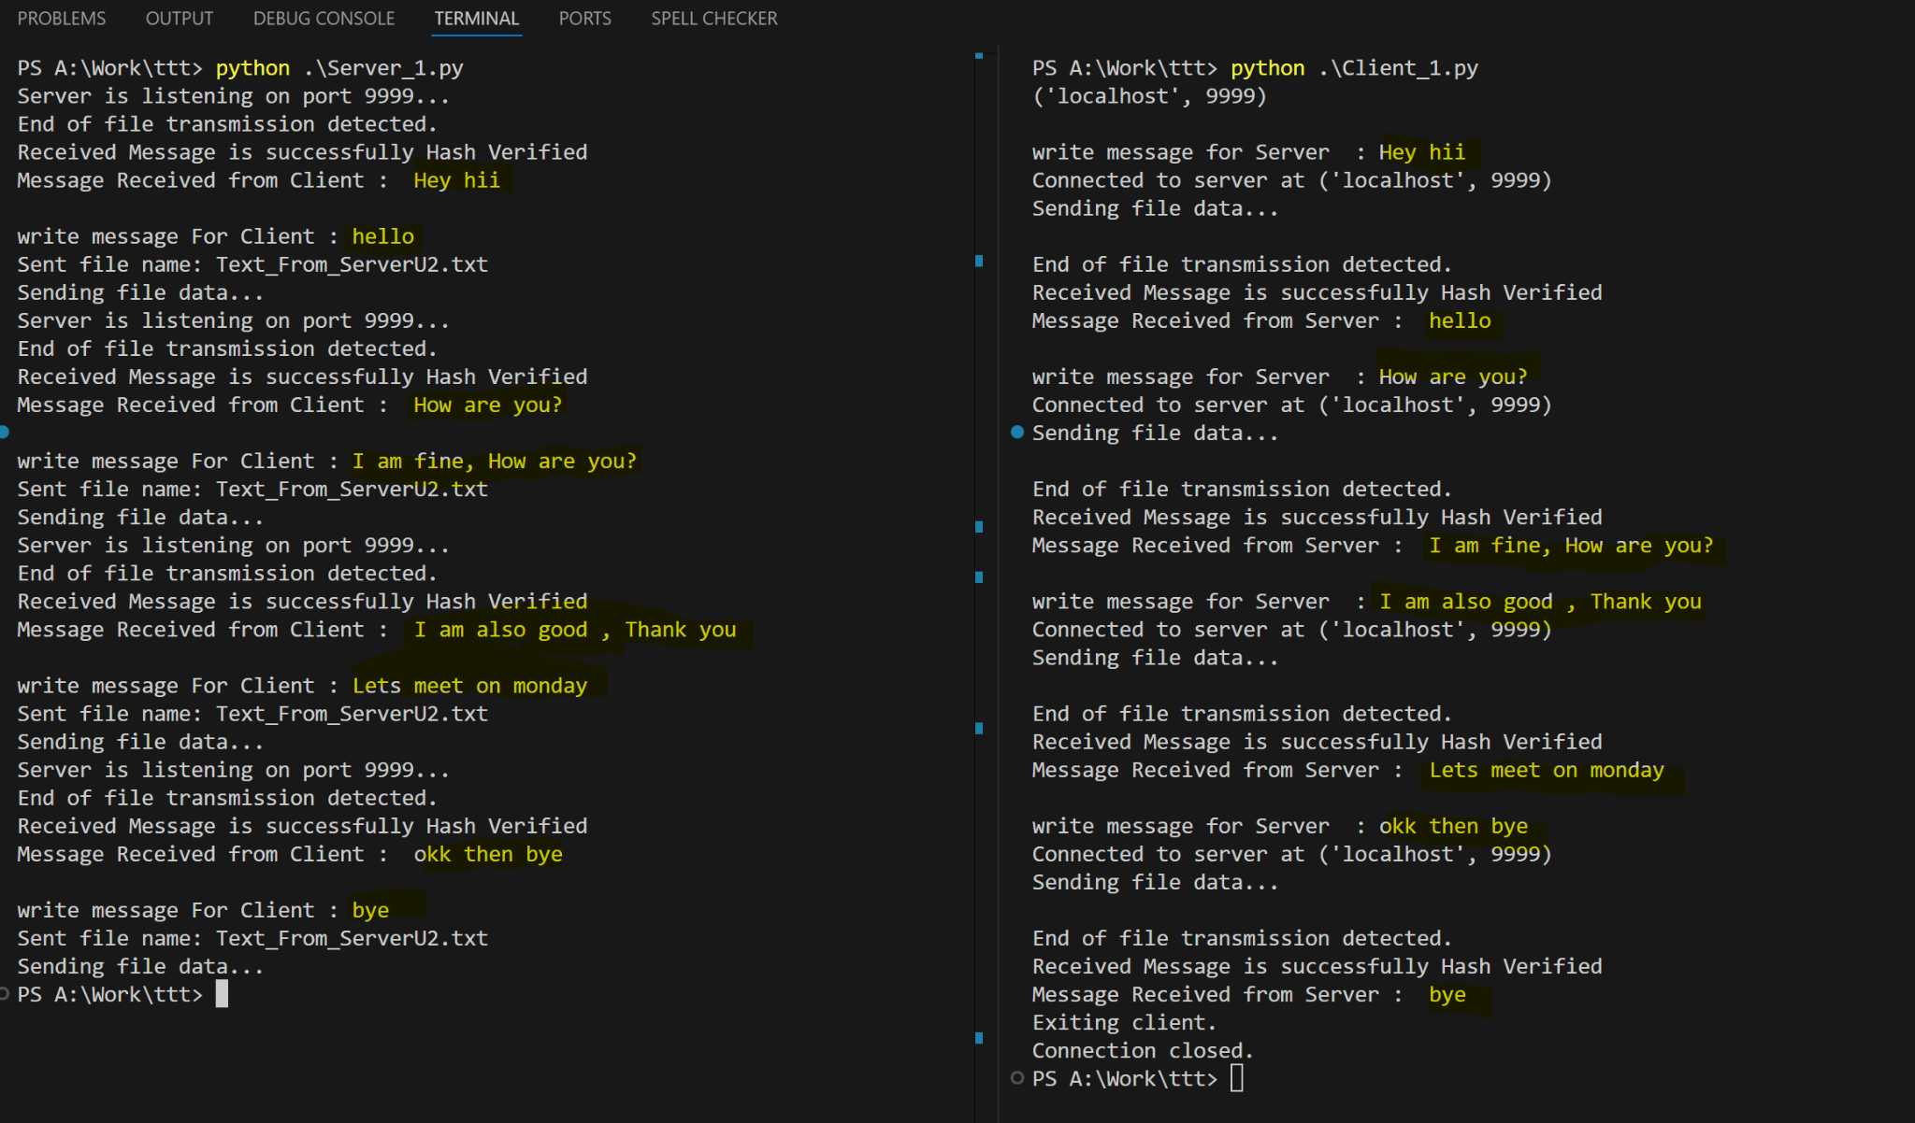
Result

Slide 11

Use the app for secure File transfer
Add multiple users
Enhance the App on WLAN
Future Improvements

Slide 12
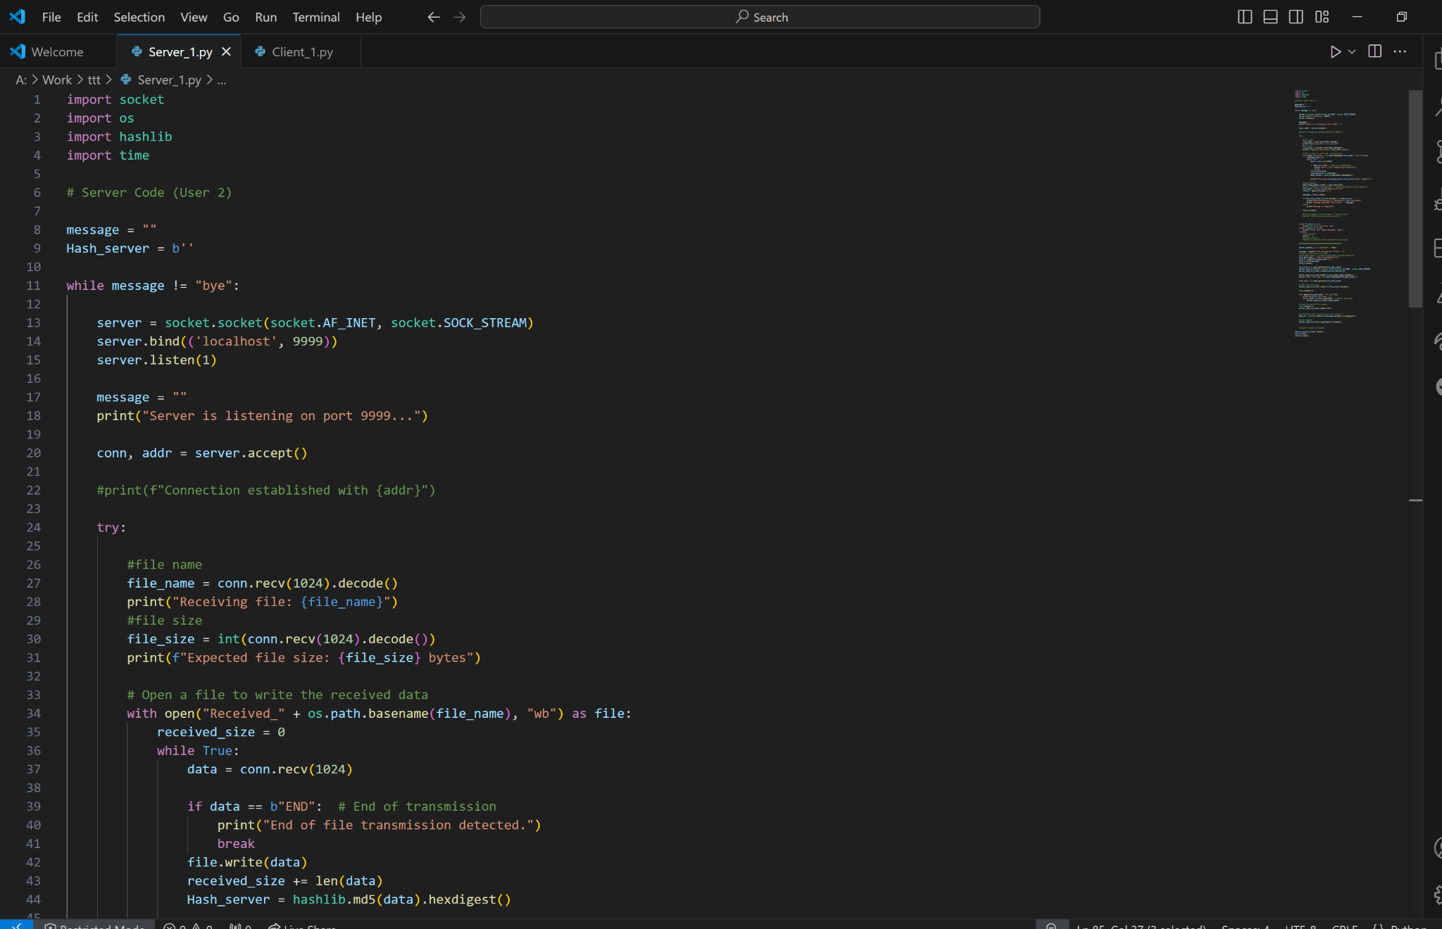
Server Code:

Slide 13
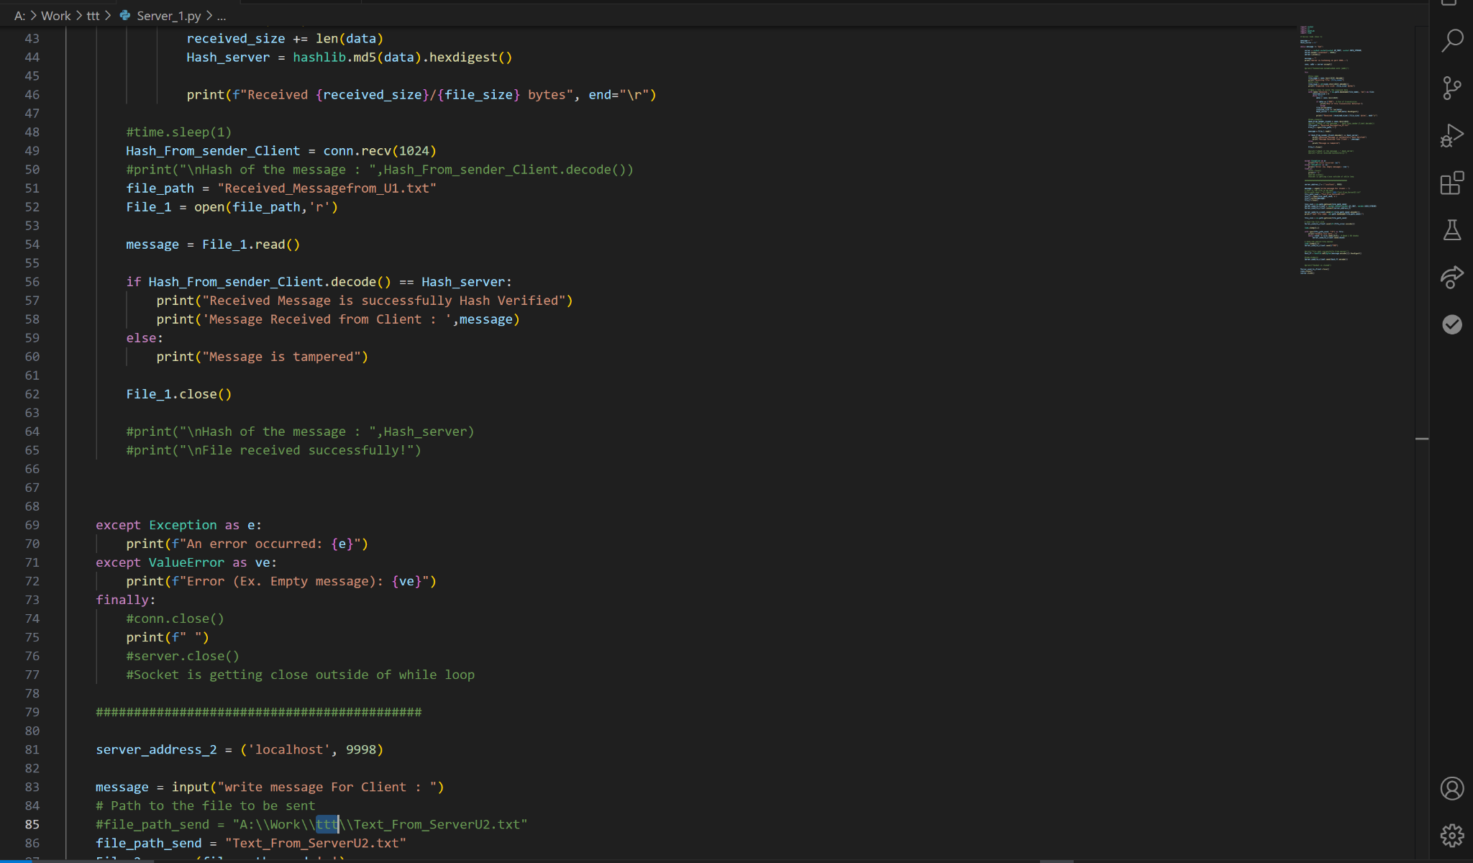

Slide 14
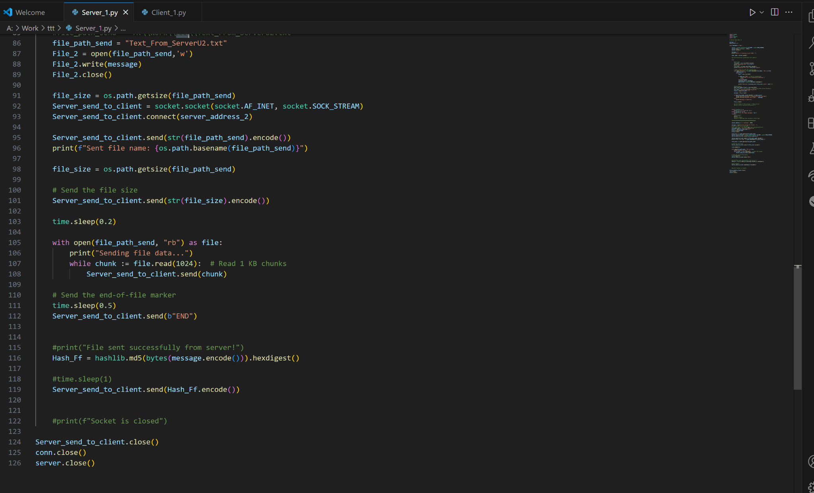

Slide 15
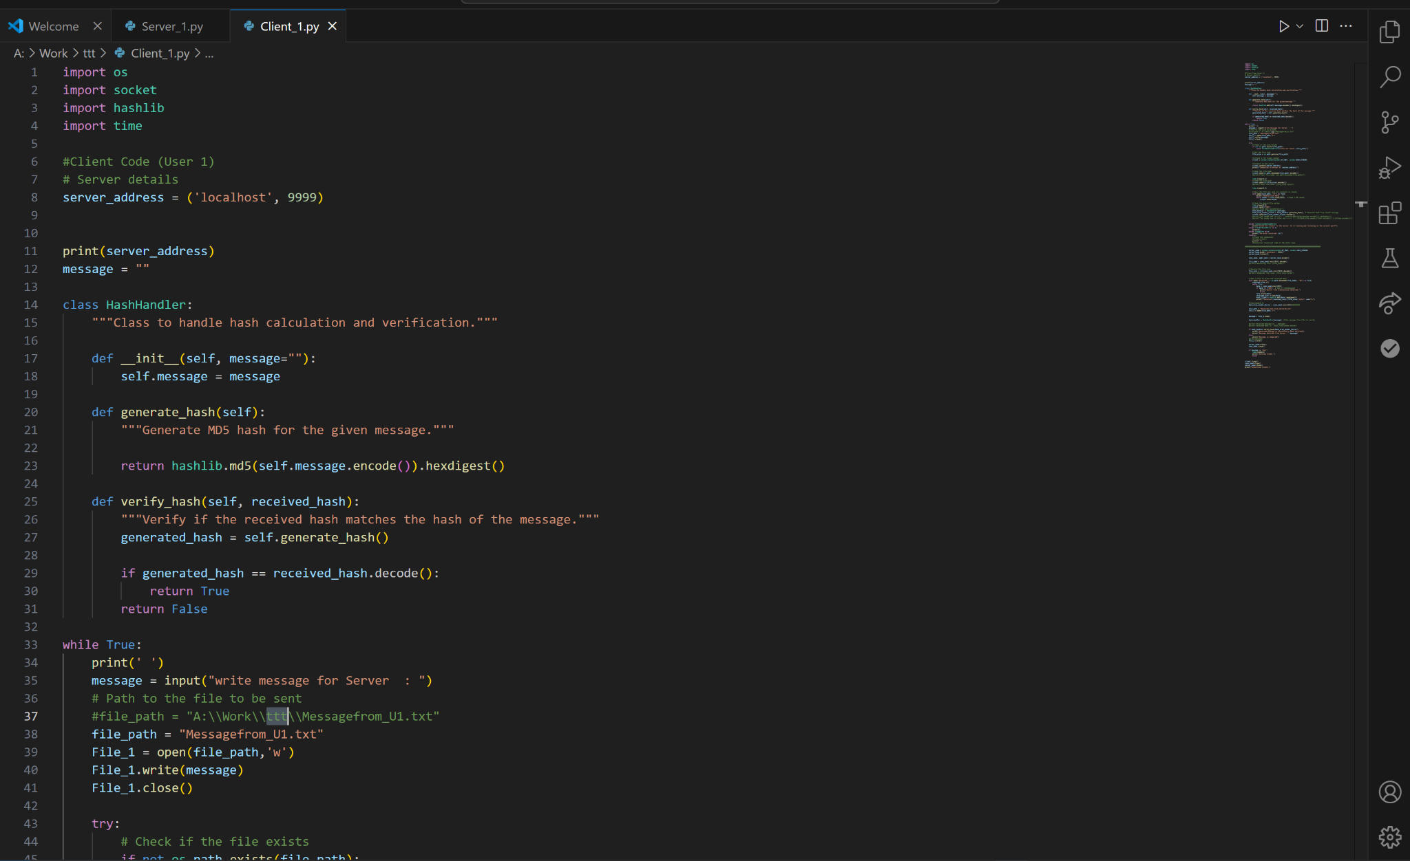
Client Code:

Slide 16
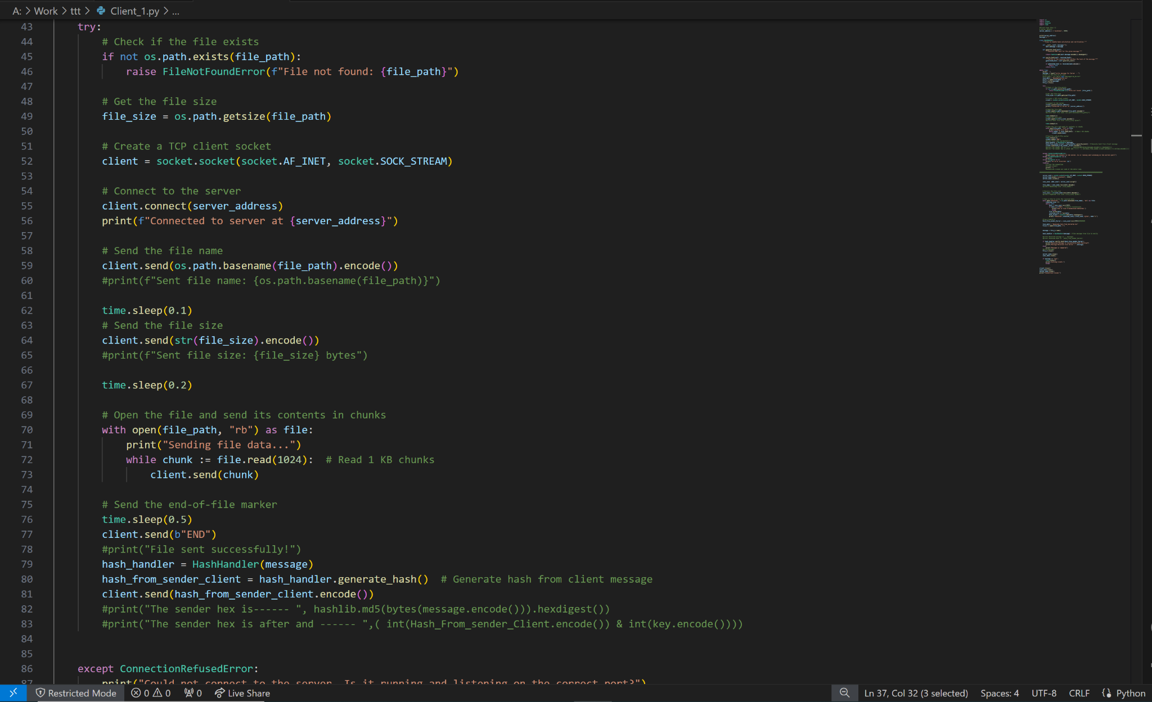

Slide 17
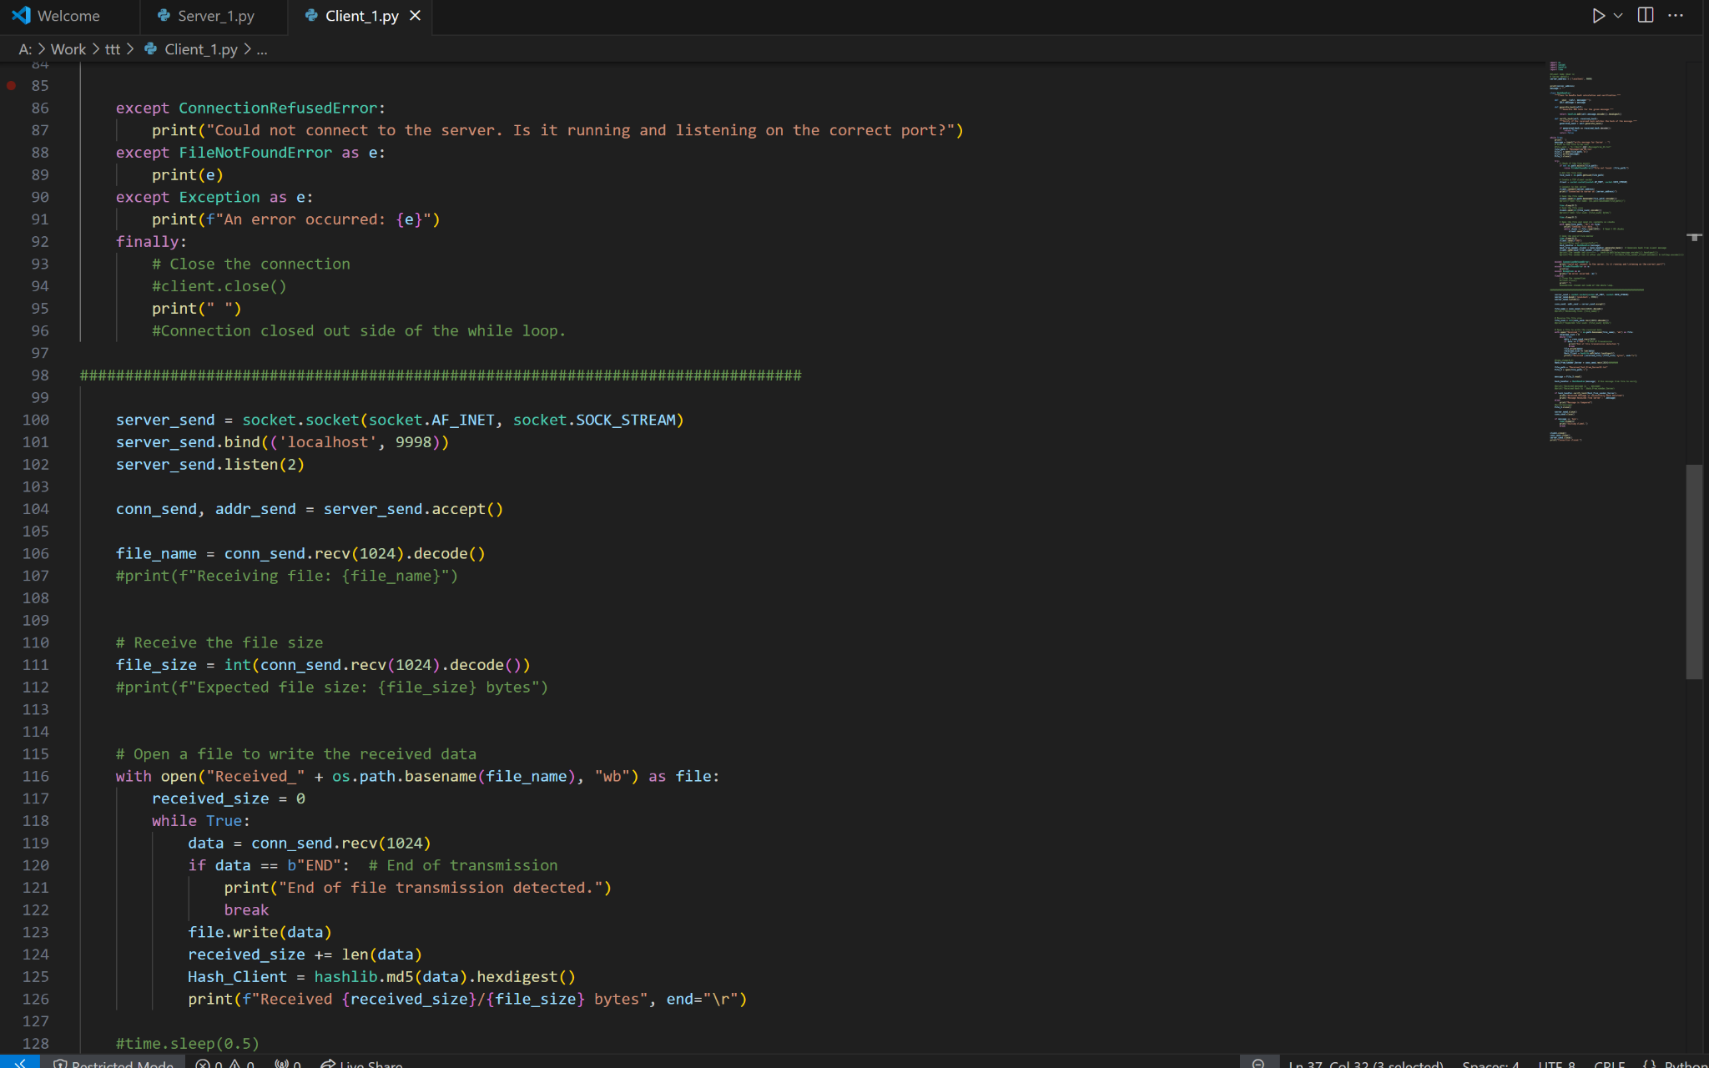

Slide 18
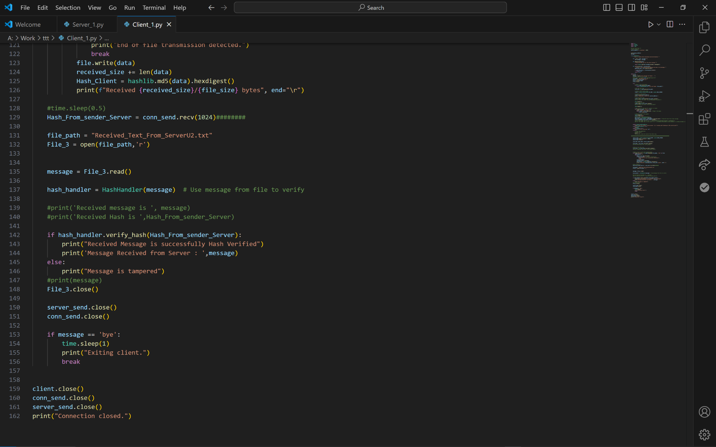

Slide 19
Thank You …!!!

